Slide 1
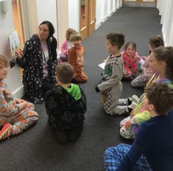
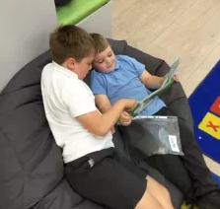
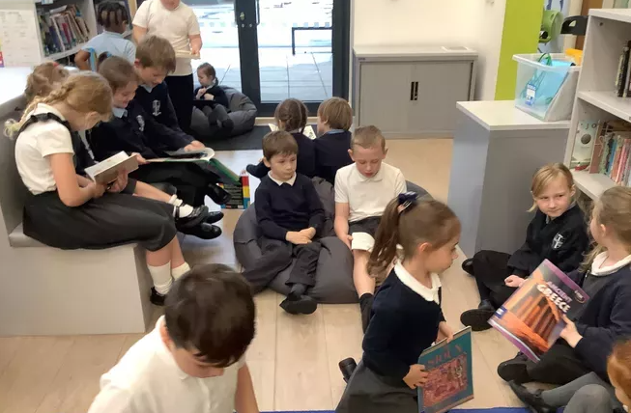




St White’s Primary School
Reading at St White’s
celebrate
challenge
commit
conquer

Slide 2
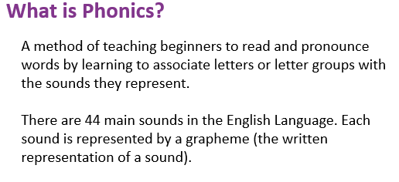
St White’s Primary School
Reading in reception and Key Stage 1
Starting from their second week in reception, all pupils in reception and year 1 are taught to read through daily phonics lessons.
celebrate
challenge
commit
conquer

Slide 3
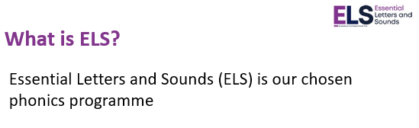
St White’s Primary School
celebrate
challenge
commit
conquer

Slide 4
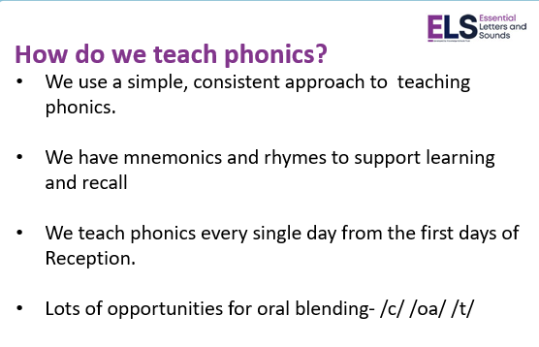
St White’s Primary School
celebrate
challenge
commit
conquer

Slide 5
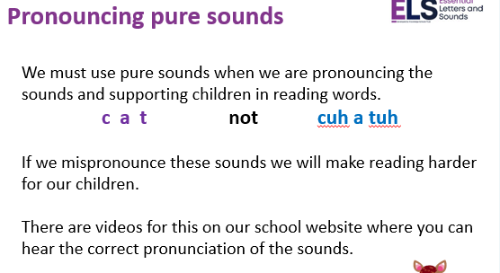
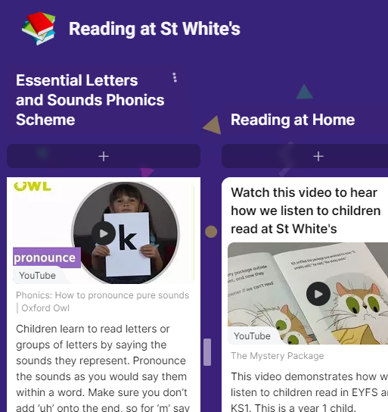
St White’s Primary School
celebrate
challenge
commit
conquer

Slide 6
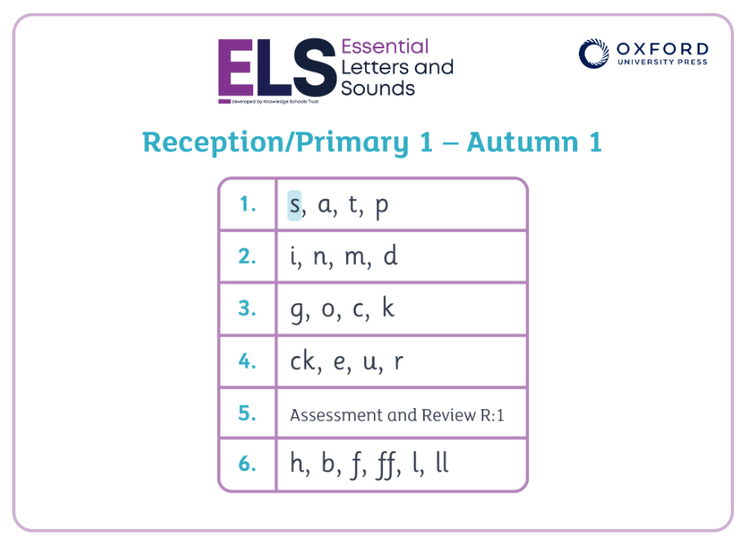
St White’s Primary School
Let’s look at a lesson
celebrate
challenge
commit
conquer

Slide 7
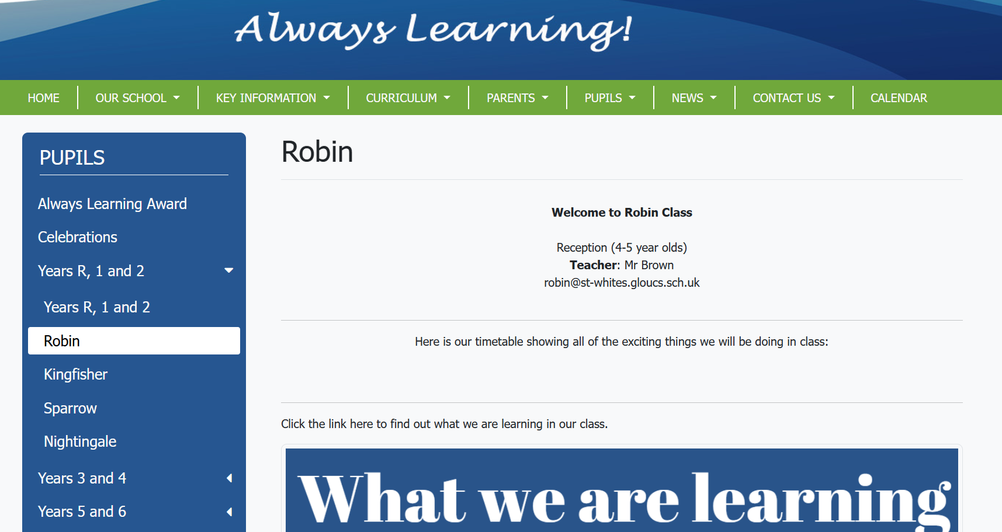
St White’s Primary School
Where can you find more help and support with Phonics at home?
celebrate
challenge
commit
conquer

Slide 8
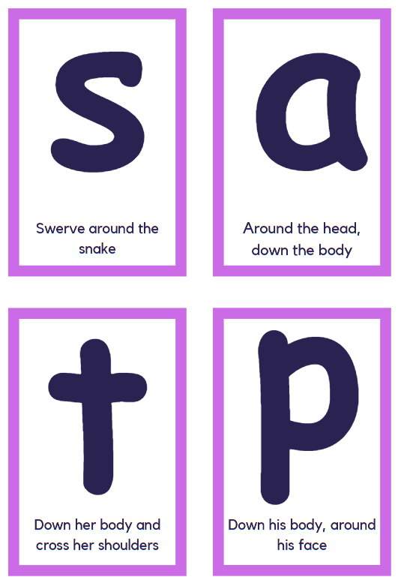

St White’s Primary School
Flashcards
celebrate
challenge
commit
conquer

Slide 9
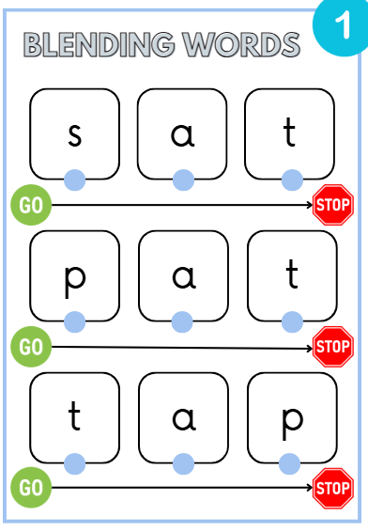
St White’s Primary School
Oral Blending Words
celebrate
challenge
commit
conquer

Slide 10
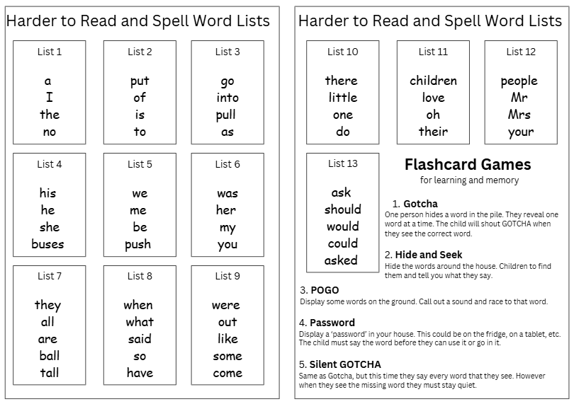
St White’s Primary School
Homework Diary
Recording Homework
celebrate
challenge
commit
conquer

Slide 11
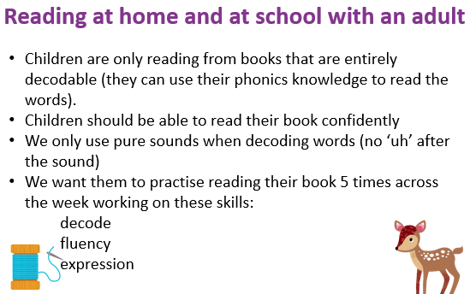
St White’s Primary School
celebrate
challenge
commit
conquer

Slide 12
St White’s Primary School
Reading Progression
At the start of their reading journey in reception and year 1, pupils move through levels 1-20. The books that they read at school and at home are based on these levels.
To be working within age-related, pupils should reach level 12 by the end of reception and level 20 by the end of year 1.
As pupils move into KS2, they can choose from a range of short stories and longer novels. Books are banded to ensure that pupils can read books that are challenging but age-appropriate.
Please see the ‘Reading Schemes 2023-24’ document on the school website for more information
celebrate
challenge
commit
conquer

Slide 13
St White’s Primary School
Parents:
Please take a copy of the ‘1:1 reading at St White’s’.
This is to support with listening to children read.
celebrate
challenge
commit
conquer

Slide 14
Important points to consider for reading at home:
Sessions should last no longer than around 10 minutes (could be longer, but no need to read the whole book every time).
Encourage children to be ‘in charge’ of the book by turning the pages themselves etc.
Encourage the child to use their phonics knowledge to sound out the word (only for phonetically decodable words). Ensure that they blend every word before trying to sound out the next word.
Use the pause, prompt, praise technique

Slide 15
Questions to ask…
Who are the main characters?
What do you think will happen next?
How do you think that character feels? Why? How would you feel in that situation?
Can you predict how the book will end?
Who is your favourite character? Why?
Would you recommend this book to a friend? Why/why not?
What was your favourite part?

